Slide 1
CROWD
SHIELD AI
Jaanga- Rajalakshmi Engineering College

Slide 2
Donie Pepin B - 241801064 AIDS (Rajalakshmi Engineering College)
Jeyaguru M - 241801108 AIDS (Rajalakshmi Engineering College)

Slide 3
PROBLEM STATEMENT
Crowd situations are dynamic and unpredictable. While existing systems can detect crowd density and congestion, they provide limited support in predicting how the situation may evolve or understanding the consequences of different interventions.
There is a need for a simulation-based decision-support system that can predict crowd behavior, visualize potential risks, test “what-if” scenarios, and help operators identify safer crowd-management strategies before acting.

Slide 4
The Problem
When Crowds Become Dangerous Large gatherings such as:
$ Concerts Stadium events
$ Festivals Religious gatherings
$ Railway stations
$ Public celebrations
can rapidly develop dangerous crowd conditions.

Slide 5
Key challenges:
Overcrowding
High population density can reduce individual movement and create dangerous pressure.
Poor Management Coordination
Blind Exposure to management plans and critical situation.
Sudden Crowd Surges
Unexpected movement can rapidly increase density in a specific zone.
Delayed Response
Traditional monitoring often identifies a problem after congestion has already become severe.
Lack of Scenario Testing
Event organizers have limited ability to ask:
“What happens if this gate fails right now?”

Slide 6
PROBLEM SOLUTION
CrowdShield AI is a crowd prediction and decision-support simulator that analyzes crowd video, predicts how the situation may evolve, recreates it in a 3D Digital Twin, and allows operators to test different “what-if” interventions before choosing a safer strategy.
Which gives the event management and handling of events much more smoother

Slide 7
CrowdShield AI — From Detection to Decision
CrowdShield AI is a predictive crowd-management platform that combines Computer Vision, Crowd Analytics, Risk Prediction, Digital Twin Simulation, and AI-assisted Decision Making.
How it works:
1. Monitor : Analyze CCTV footage or simulated crowd video.
2. Understand : Detect people and calculate density, movement, flow, and congestion.
3. Predict : Estimate whether a zone is moving toward a dangerous state.
4. Simulate : Use the Digital Twin to test possible interventions.
5. Decide : Select the safest feasible intervention.
6. Communicate : Generate instructions for signs, security personnel, public announcements, or mobile users.
7. Verify : Observe the crowd again and measure whether the intervention reduced risk.

Slide 8
Key idea:
Traditional approach: Detect → Alert
CrowdShield AI: Detect → Predict → Simulate → Decide → Act → Verify
Visual:
Place the two approaches side by side. Make the CrowdShield pipeline much larger,
Tech Stack Used - python + fast api, react , blender gpt, sql lite, vite 5, css, websockets, bytetrack & yolo , numpy

Slide 9
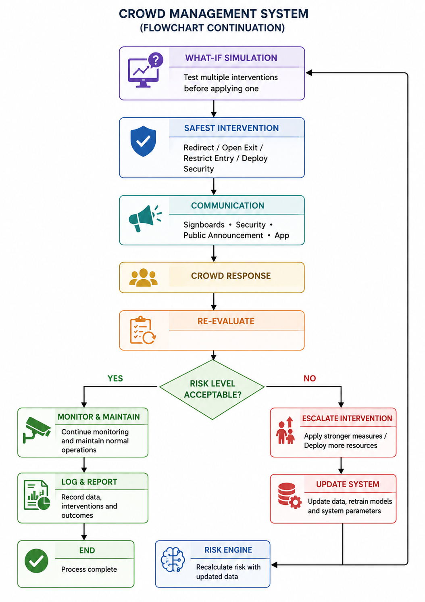
BLOCK DIAGRAM/FLOW CHART

Slide 10
THANK YOU!

